Slide 1
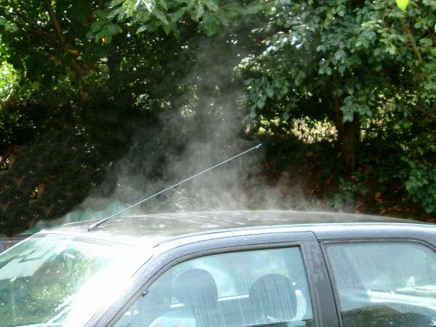
What is happening here?
Enhancing Primary Science

Slide 2
Evaporation
The water is evaporating from the surface of the car.
Enhancing Primary Science

Slide 3
Evaporation
Develop your understanding of evaporation.
Describe the term evaporation and how you can increase the rate of evaporation.
Enhancing Primary Science

Slide 4
What is evaporation?
Enhancing Primary Science

Slide 5
Evaporation is the process by which a liquid turns into a gas.
Enhancing Primary Science

Slide 6
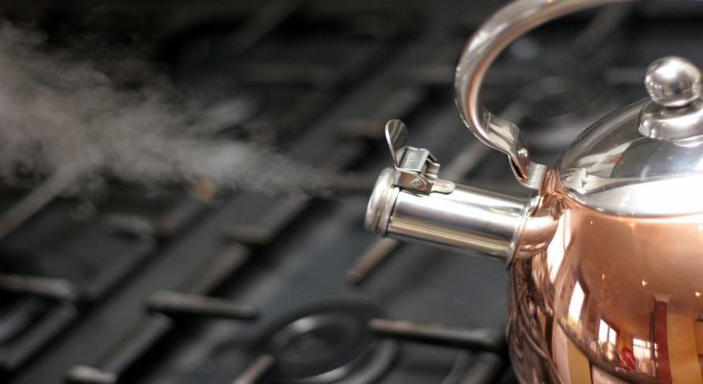
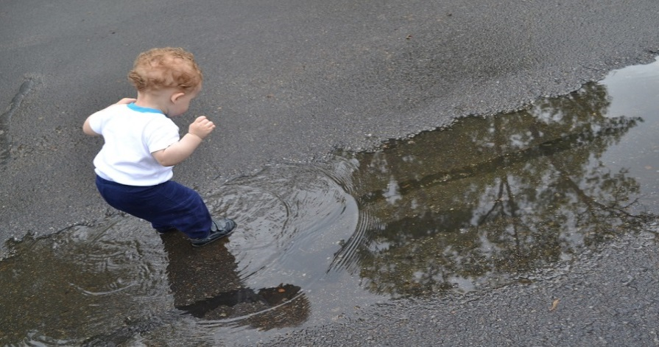
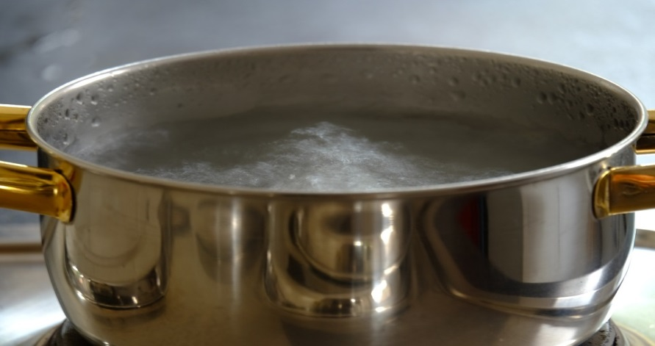
Where do you see evaporation happening?
Enhancing Primary Science

Slide 7
Let us look at the pan boiling
Enhancing Primary Science

Slide 8
What is happening?
Science is the study of the world around us by observing things and explaining why they happen.
So what do we think is happening and why?
Enhancing Primary Science

Slide 9
What is happening?
Science is the study of the world around us by observing things and explaining why they happen.
So what do we think is happening and why?
Lets look back to the work we did on particles.
Enhancing Primary Science

Slide 10
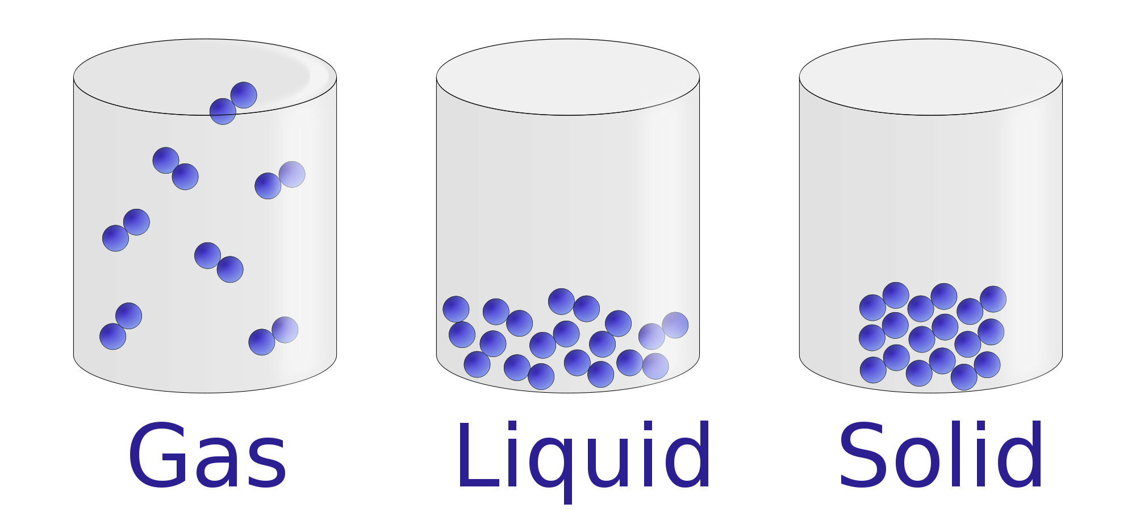
Which particles do you think have most energy, particles of a liquid or of a gas?
Need a clue?
Which particles are moving around the fastest?
Enhancing Primary Science

Slide 11
The faster particles move around the more energy they have
Enhancing Primary Science

Slide 12
So what do we think is happening and why?
The particles of liquid water in the pan are moving around. When we heat up the pan, the particles of water gain more energy so start moving around even faster. They gain enough energy that they can escape from the pan in the form of steam / water vapour (a gas). This is called evaporation.
Enhancing Primary Science
Notes:
Pupils demonstrating this always goes down well. Pupils act as particles and start moving around faster and faster.

Slide 13
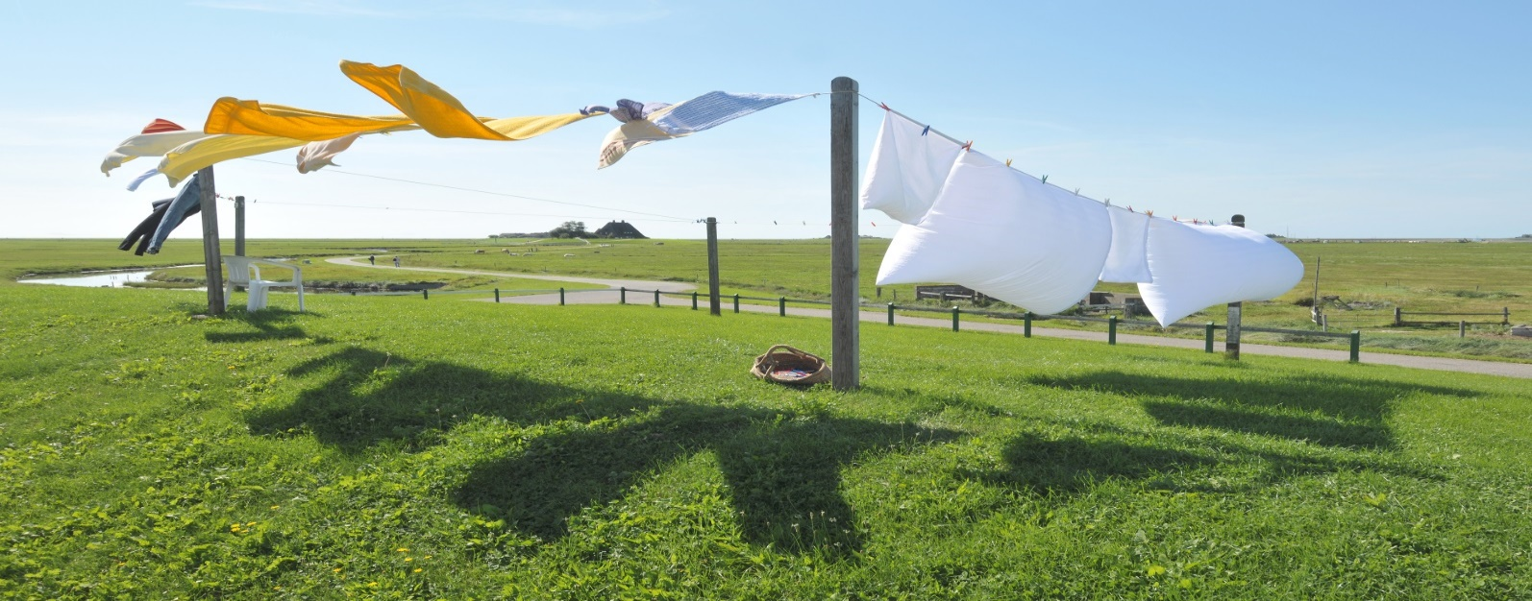
What affects the rate of evaporation; how can we speed up how fast evaporation happens?
Clue?
What are the best weather conditions for drying your clothes outside?
Enhancing Primary Science

Slide 14
What affects the rate of evaporation; how can we speed up how fast evaporation happens?
Clue?
What are the best conditions for drying your clothes?
The warmer and windier the conditions; the faster the rate of evaporation.
Enhancing Primary Science

Slide 15
investigation
Enhancing Primary Science

Slide 16
What can we investigate and how will we do it?
In your groups discuss
Enhancing Primary Science

Slide 17
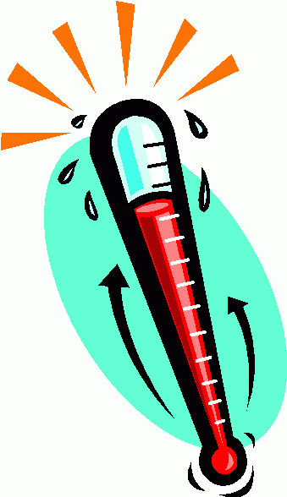
How does temperature affect rate of reaction?
Enhancing Primary Science

Slide 18
Variables
In all investigations:
The independent variable is………
What I change
The dependent variable is………..
What I measure
The control variables are………….
What I keep the same to ensure a fair test
Enhancing Primary Science

Slide 19
Variables
The independent variable is………
The temperature of the surroundings (where you will put it)
The dependent variable is………..
How long it takes to evaporate
The control variables are………….
Same amount of water, same container, same starting temperature of water
Enhancing Primary Science

Slide 20
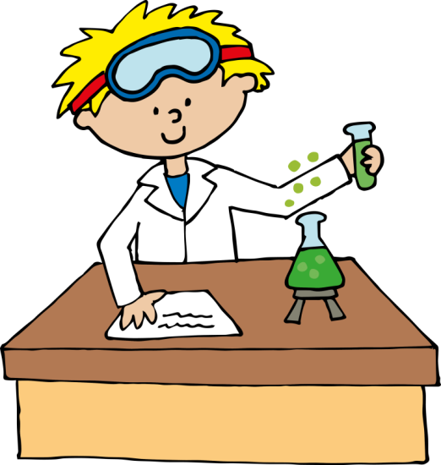
Prediction
Why do good scientists make predictions?
A good scientist will always make predictions before an investigation to state what they think will happen and why it may happen.
Enhancing Primary Science
Notes:
Depending on logistics and available equipment, ideally 3 containers per group and let in 3 different places eg) cupboard, windowsill and outside.

Slide 21
Improvements
With your partner, take it in turns to read through what you have written and work out between you if there is any improvements to make.
Enhancing Primary Science

