Slide 1
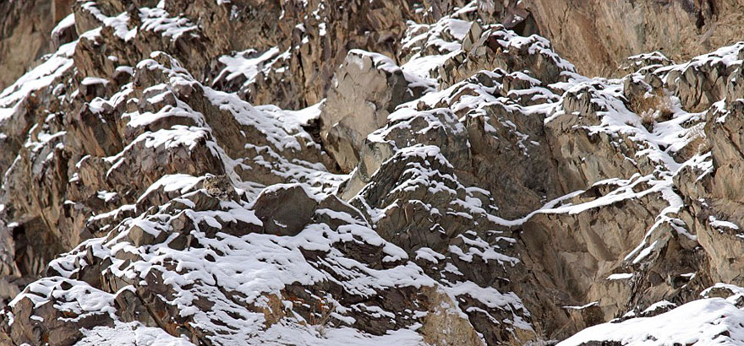
Can you see the snow leopard?
a
Enhancing Primary Science

Slide 2
Can you see the snow leopard?
a
Enhancing Primary Science

Slide 3
Natural Selection
Further develop your understanding of evolution and natural selection.
Recall the story of recent evolution and solve the problem of growth and fall in numbers of the peppered moth.
Enhancing Primary Science

Slide 4
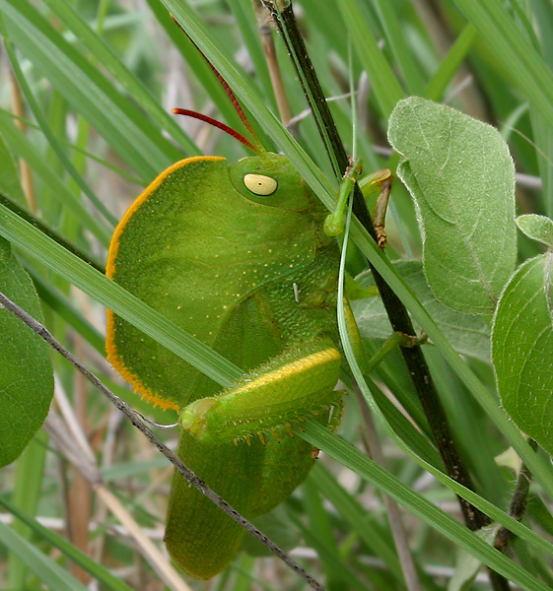
Find the insect
Enhancing Primary Science

Slide 5
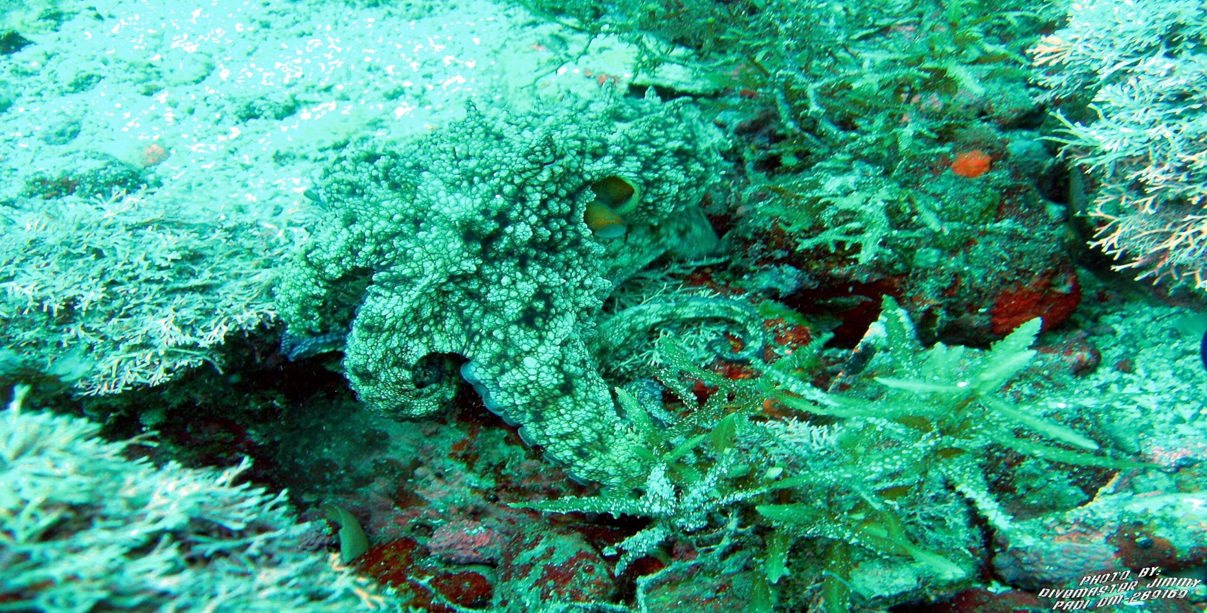
Find the octopus
Enhancing Primary Science
Notes:
Amazing YouTube clip on camouflaged octopus

Slide 6
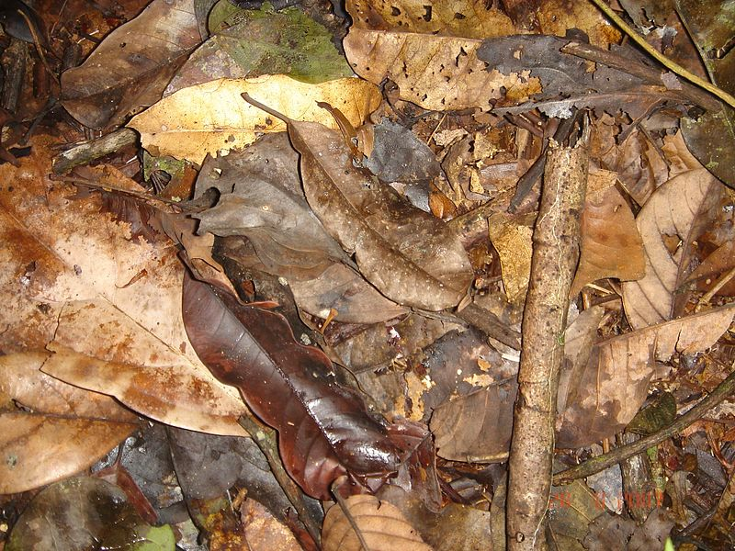
Find the frog
Enhancing Primary Science

Slide 7
All These Animals Are Masters of Camouflage
Why is this important?
What will this mean for these animals?
Will they live longer?
Will they reproduce and bare offspring?
Enhancing Primary Science

Slide 8
Golden Rules
What are your top 3 points about the importance of camouflage?
Hide from predators and from prey, live longer, better chance of reproducing.
Enhancing Primary Science

Slide 9
Evolution explains how life on Earth has changed over time.
Adaptations are the features of a living organism that have to help them live in a particular habitat.
A habitat is a place where an organism lives (woodland, pond).
Natural Selection is the idea that individuals with characteristics most suited to the environment are more likely to survive and reproduce.
Enhancing Primary Science

Slide 10
How many circles are there?
Enhancing Primary Science

Slide 11
30
Were some easier to see than others?
Enhancing Primary Science

Slide 12
Class Hunt
Around the room are some black squares and white squares. You have 30 seconds to find as many as you can.
Enhancing Primary Science
Notes:
If time, stick small coloured squares that are hard to find and ones coloured so they are easy to see.

Slide 13
Story Time
Enhancing Primary Science

Slide 14
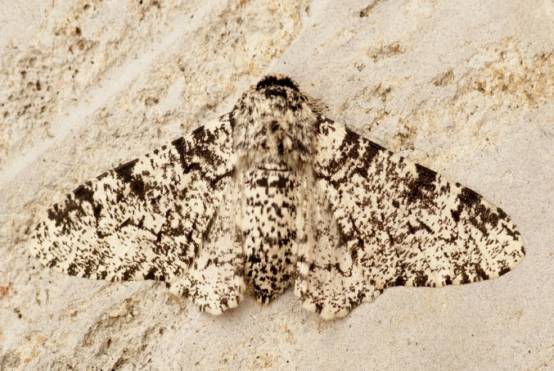
Once upon a time…
A long, long time ago, before the industrial revolution in Britain, trees like the birch tree were pale in colour and most peppered moths were pale in colour too. What did this mean for the white moths?
This meant they were camouflaged.
Enhancing Primary Science

Slide 15
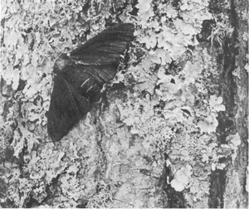
But a few were black. What do you think this meant for the black moths landing on these white trees?
Yes, they were easily spotted and eaten by predators.
Enhancing Primary Science

Slide 16
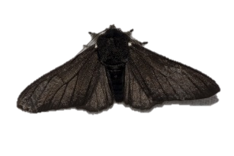
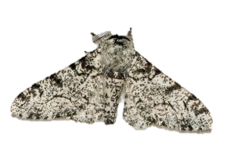
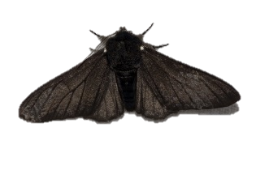
So, what happened to the numbers of each?
Population of white moths
Population of black moths
Enhancing Primary Science

Slide 17
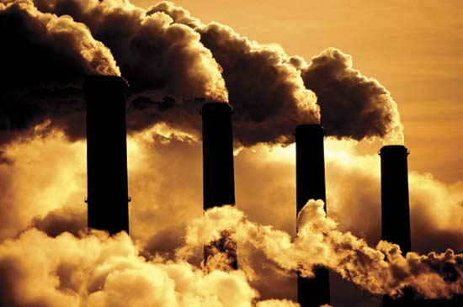
That’s until the factories started pumping out lots of black soot and dust.
Enhancing Primary Science

Slide 18
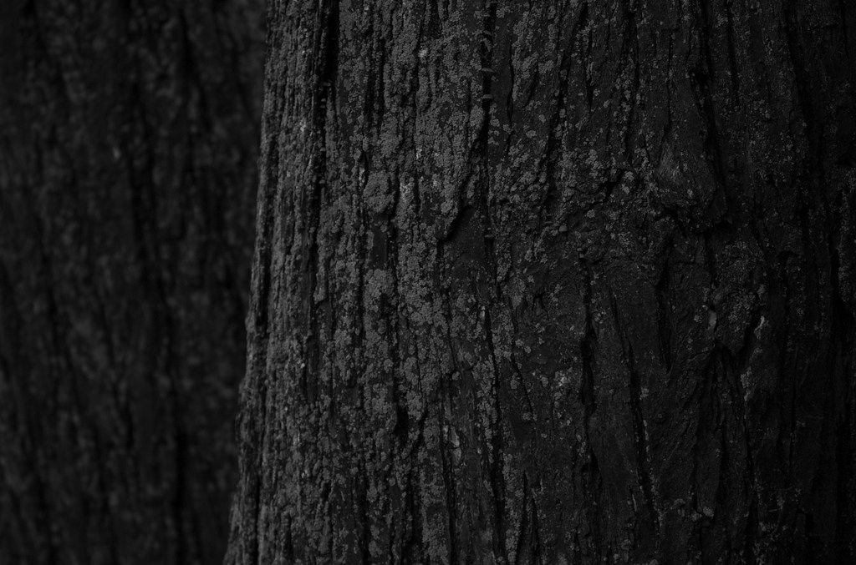
What colour did this cause the trees to turn?
Enhancing Primary Science

Slide 19
So, how did this make life for the white peppered moth?
And the black moth?
Enhancing Primary Science

Slide 20
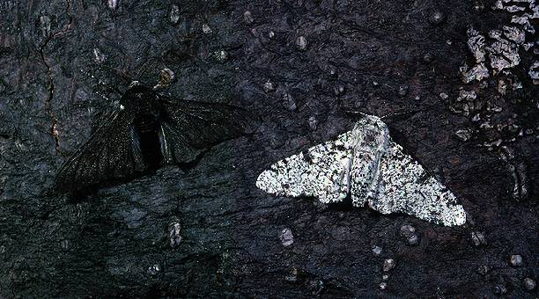
Enhancing Primary Science

Slide 21
What happened to the numbers of each?
Population of white moths
Population of black moths
Enhancing Primary Science

Slide 22
Then, over many years, the country started to clean up their act and smoke and soot became less of a problem so the trees began to turn…
Enhancing Primary Science

Slide 23
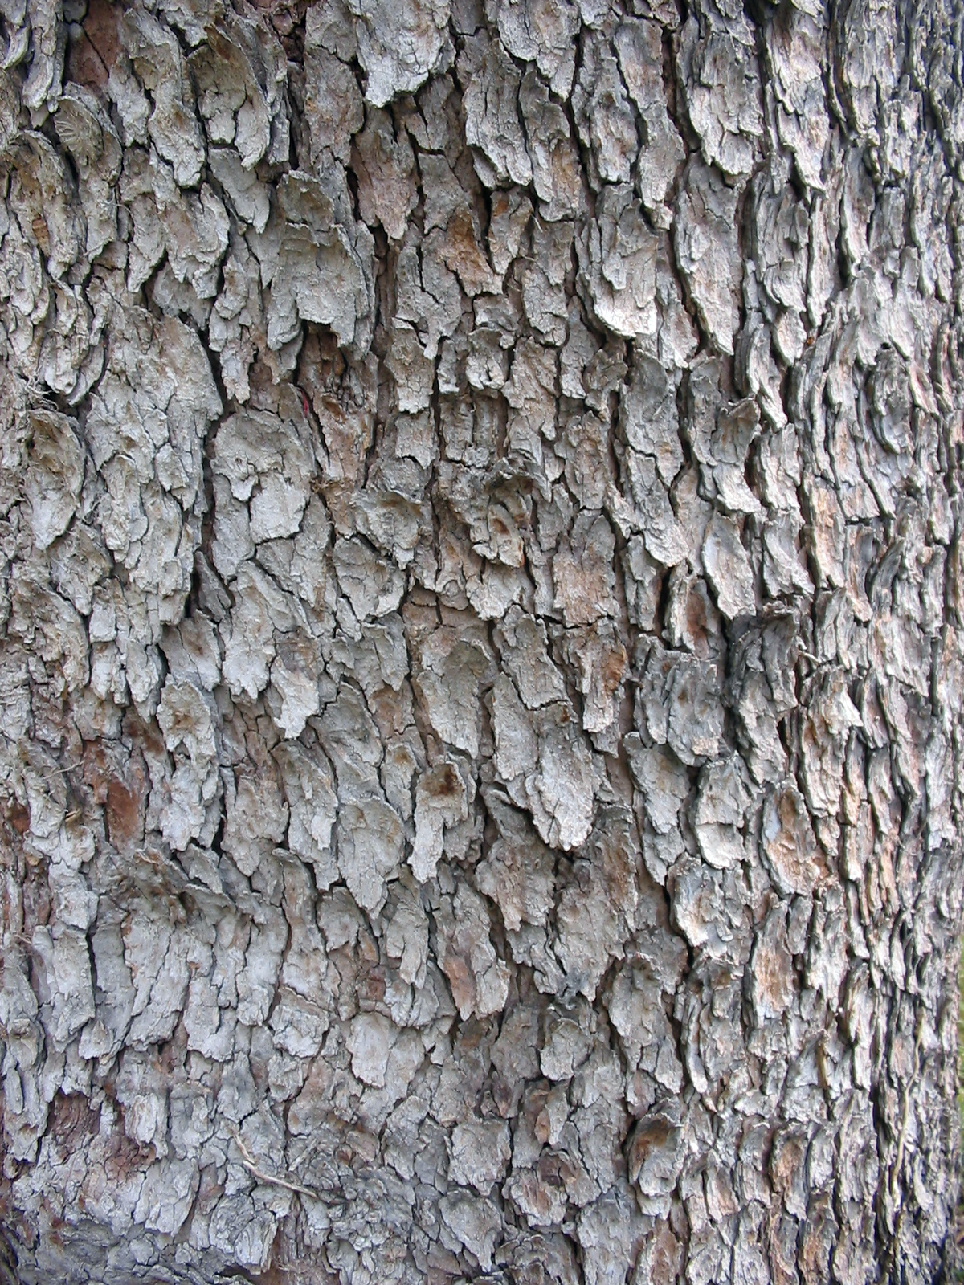
Enhancing Primary Science

Slide 24
So...how did this make life for the white peppered moth?
And the black moth?
Enhancing Primary Science

Slide 25
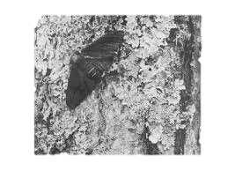
Enhancing Primary Science

Slide 26
So, what happened to the numbers of each?
Population of white moths
Population of black moths
Enhancing Primary Science

Slide 27
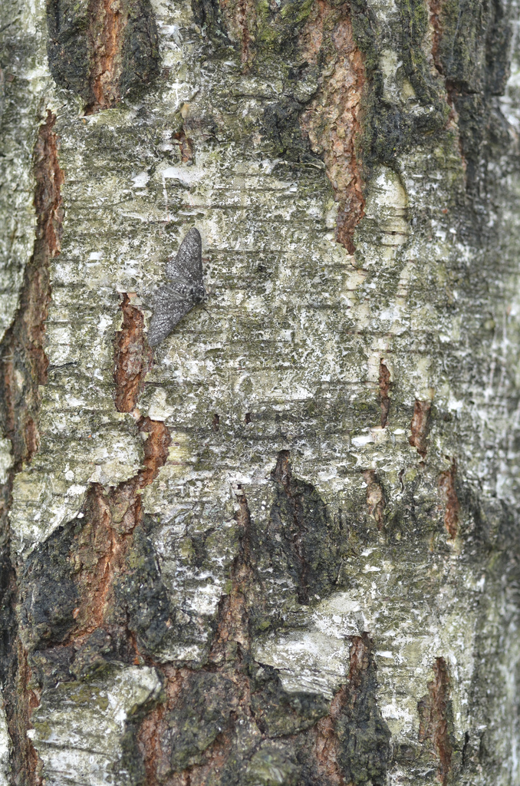
Find the moth
Enhancing Primary Science

Slide 28
Use the story board to tell the story of this recent, rapid form of natural selection.
Enhancing Primary Science

