Slide 1
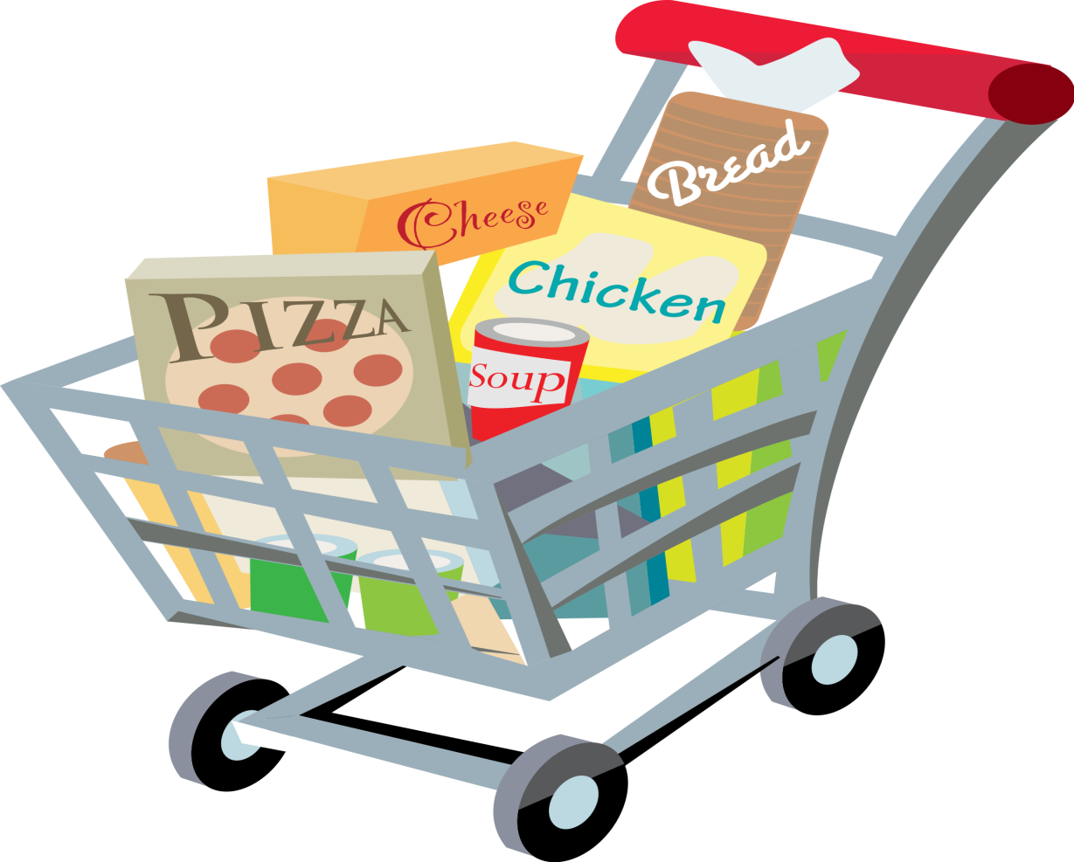
What do you carry your shopping home in?
Enhancing Primary Science

Slide 2
Enhancing Primary Science
Notes:
Teacher may need to put out different materials for the pupils to find

Slide 3
Properties of Materials
Develop your understanding of materials and their strengths.
Investigate, record your results and conclude your findings.
Enhancing Primary Science

Slide 4
Science is all about answering questions and solving problems
Enhancing Primary Science

Slide 5
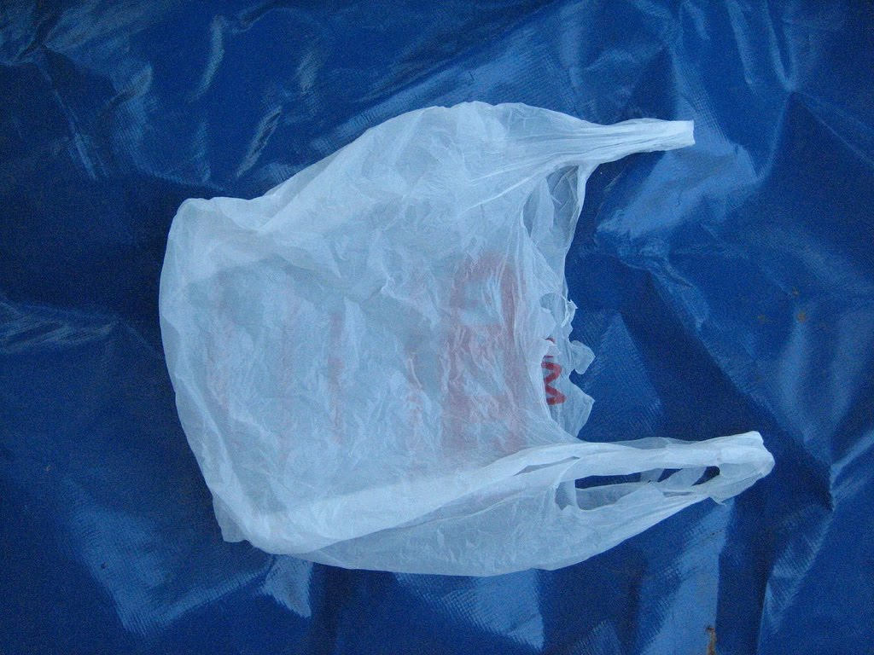
How can we make a carrier bag stronger?
Enhancing Primary Science

Slide 6
Your thoughts?
Enhancing Primary Science

Slide 7
investigation
Enhancing Primary Science

Slide 8
Investigation
Question 1: How does the length of a carrier bag handle affect its strength?
Question 2: How does the thickness of a carrier bag handle affect its strength?
Enhancing Primary Science

Slide 9
Investigation
Investigation 1: You will be given different lengths of plastic bags and you will hang weights from them until they snap.
Investigation 2: You will be given different widths of plastic bags and you will hang weights from them until they snap.
Enhancing Primary Science
Notes:
Pupils can either do just one or both of the investigations, record their results and conclude their findings.

Slide 10
Investigation 1 Variables
In all investigations:
The independent variable is………
What I change. The length of the handle
The dependent variable is………..
What I measure. Amount of weight added before the bag snaps.
The control variables are………….
What I keep the same to ensure a fair test. Same thickness of bag, same type of bag.
Enhancing Primary Science

Slide 11
Recording Results
Do you remember why it is important to record your results?
A good scientist will always record their results so other people can see what you have found out.
Enhancing Primary Science

Slide 12
Prediction (What do you think will happen?)
Why do good scientists make predictions?
A good scientist will always make predictions before an investigation to state what they think will happen.
I think the strongest bags will be made using…
Because…
Enhancing Primary Science

Slide 13
Conclusion
Make a judgement on your investigation and your findings.
Example: The longer the handle, the ______ the bag.
Enhancing Primary Science

Slide 14
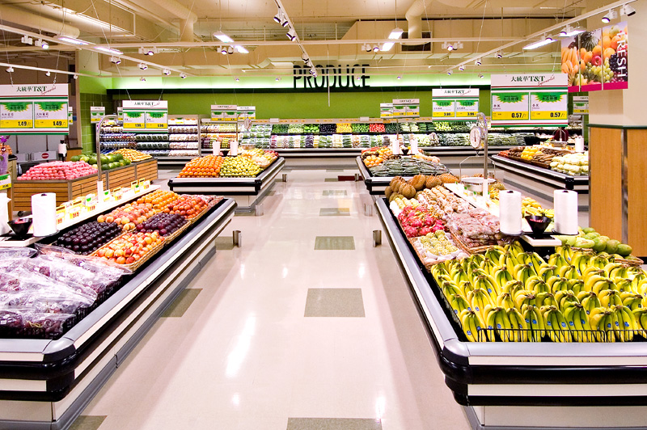
Tell The Supermarkets
Write a letter to your local supermarket telling them what you have found out and how this will help their valued customers.
Enhancing Primary Science

