Slide 1
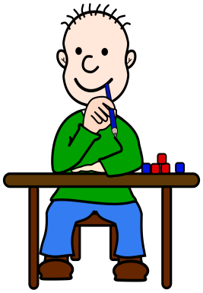
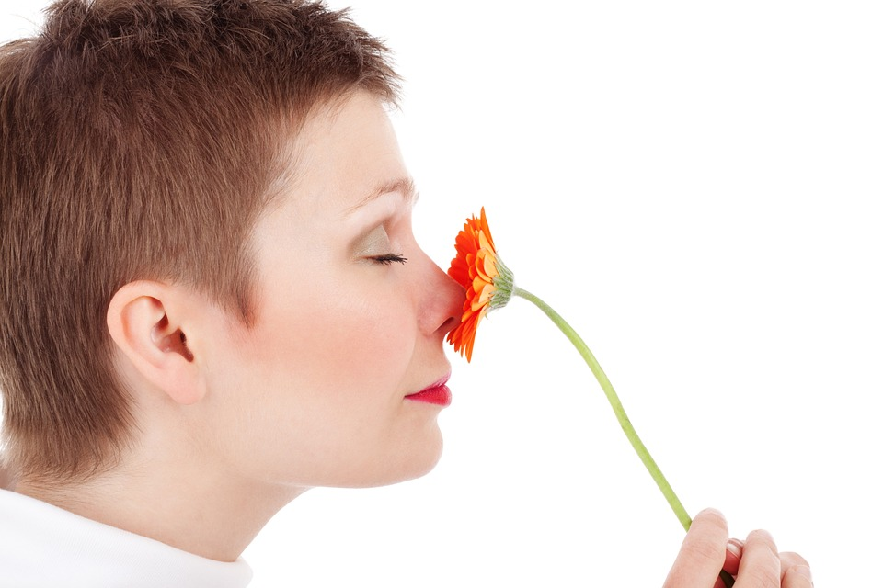
What is your favourite and least favourite smell?
Enhancing Primary Science

Slide 2
The Human Body and Our Senses
Further develop your understanding about our bodies and senses.
Name your senses and which part of the body it is associated with.
Describe why are our senses are important.
Enhancing Primary Science

Slide 3
What are the five senses?
Smell
Hear
Feel
See
Taste
Enhancing Primary Science

Slide 4
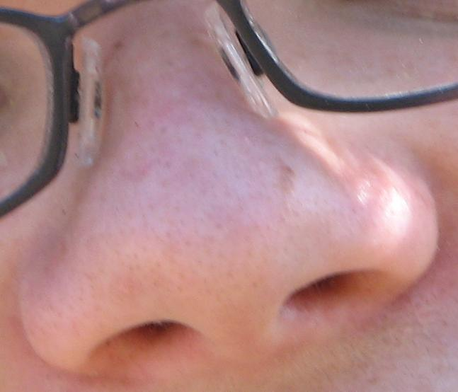
Smell
What part of our body do we use to smell?
Enhancing Primary Science

Slide 5
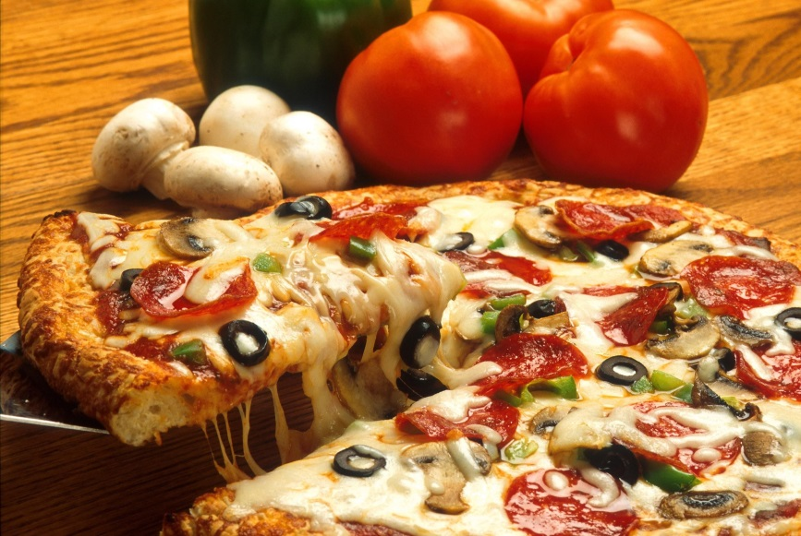
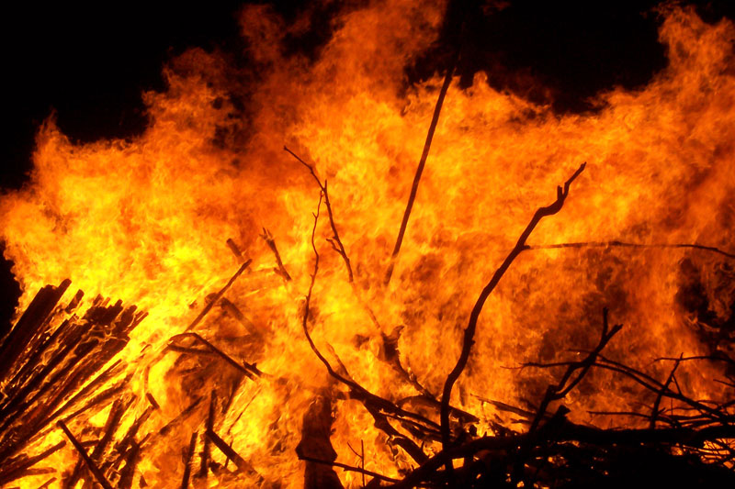
Why is it important to be able to smell?
To see if food smells good or bad.
To smell if there is a fire so you can be safe.
Enhancing Primary Science

Slide 6
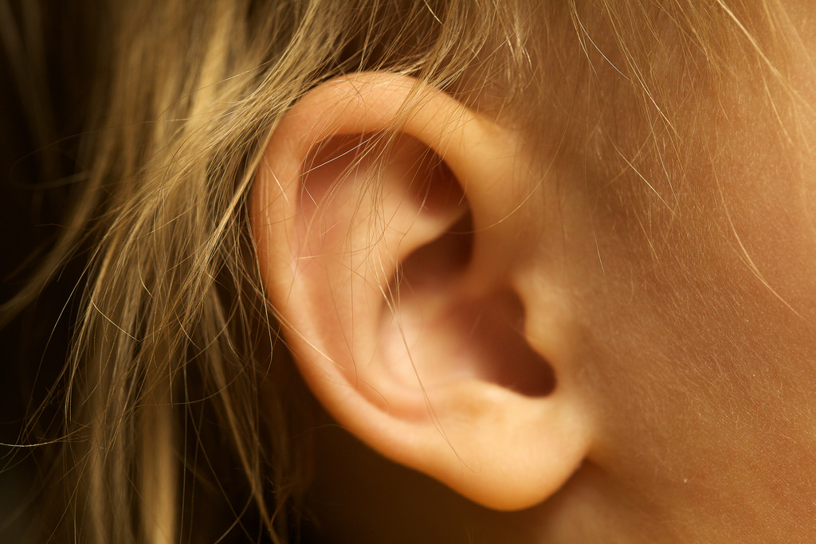
Hear
What part of our body do we use to hear?
Enhancing Primary Science

Slide 7
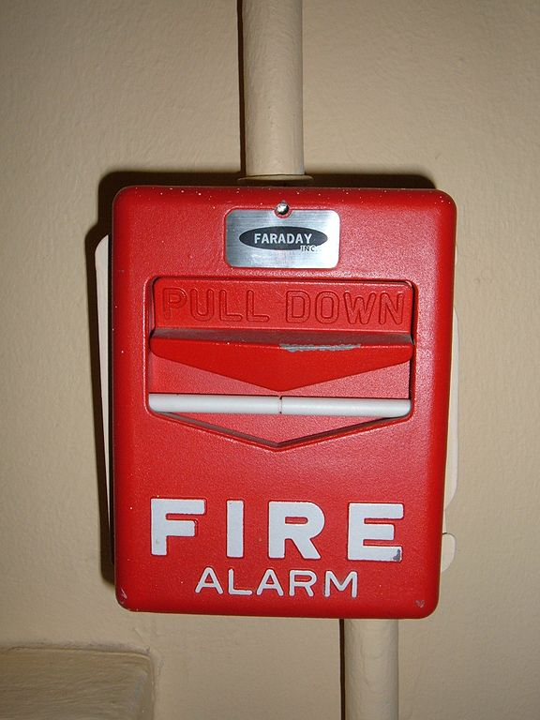
Why is it important to be able to hear?
To listen to your favourite music.
To hear an alarm if there is trouble or danger.
Enhancing Primary Science

Slide 8
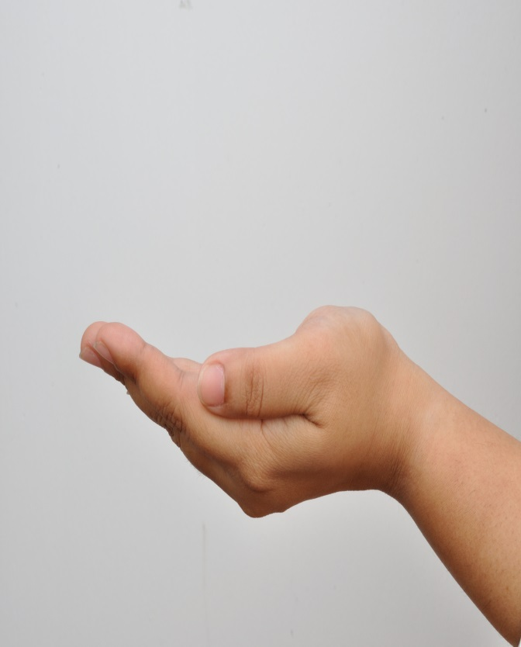
Feel
What part of our body do we use to feel?
Enhancing Primary Science

Slide 9
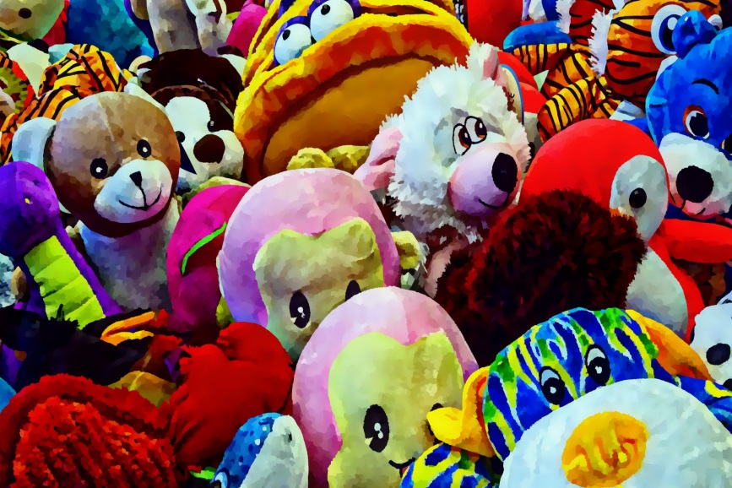
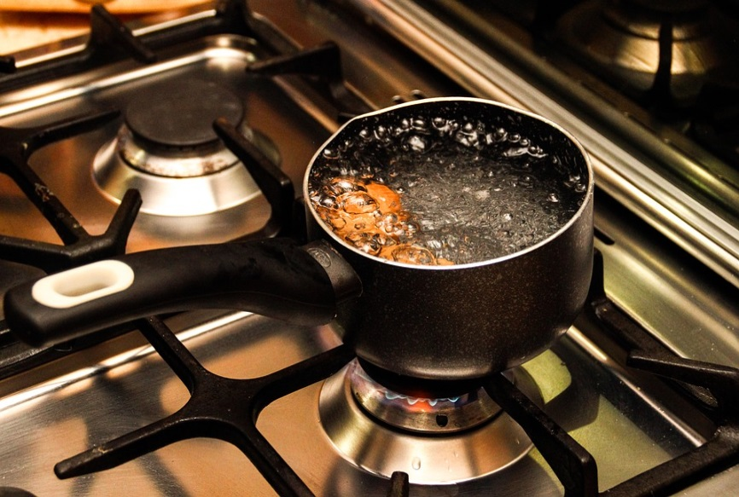
Why is it important to be able to feel?
To touch and feel your favourite toy.
To feel if something is hot.
DO NOT touch hot objects.
Enhancing Primary Science

Slide 10
What do you think the next question is?
Enhancing Primary Science

Slide 11
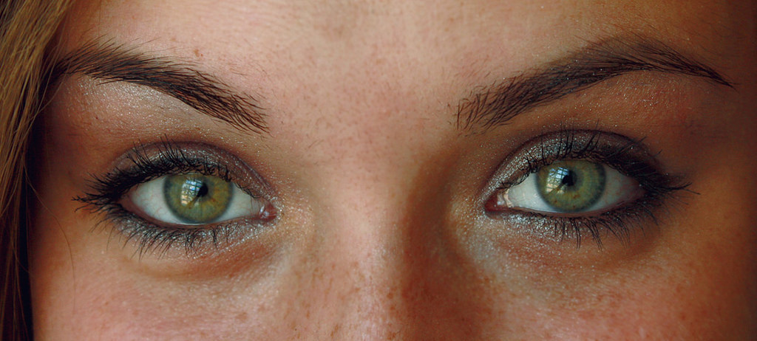
See
What part of our body do we use to see?
Enhancing Primary Science

Slide 12
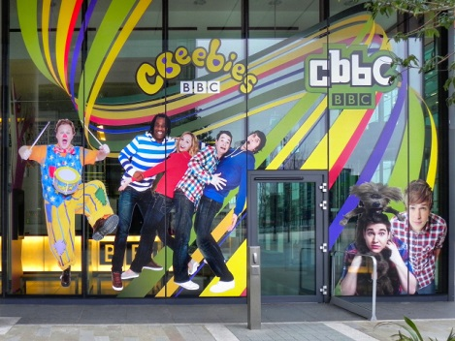
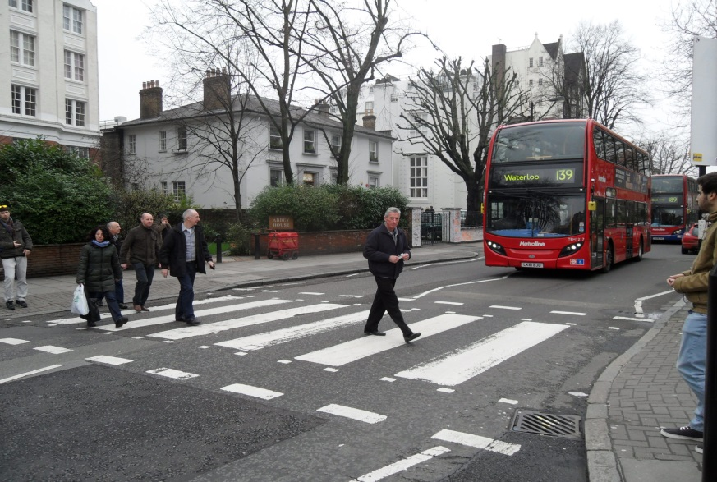
Why is it important to be able to see?
To watch your favourite TV programme.
To stay safe when crossing the road.
Enhancing Primary Science

Slide 13
And the last…
Enhancing Primary Science

Slide 14
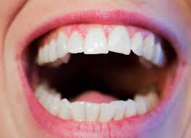
Taste
What part of our body do we use to taste?
Enhancing Primary Science

Slide 15
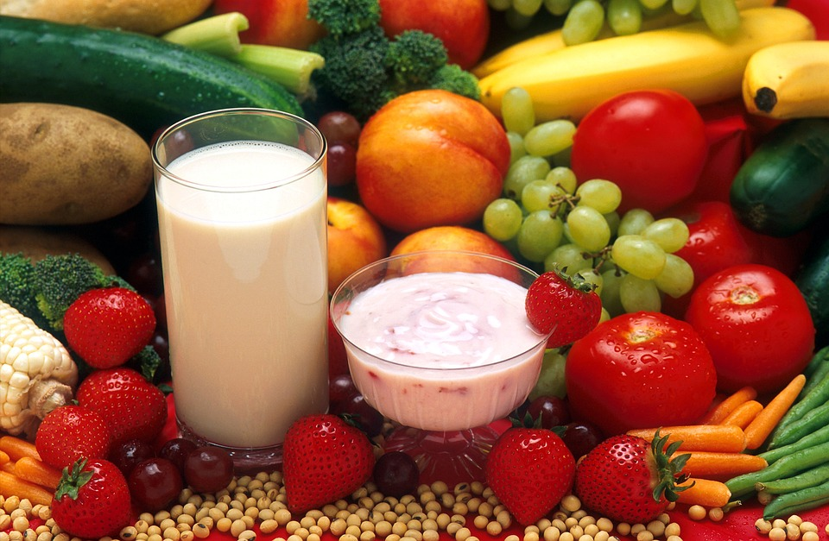
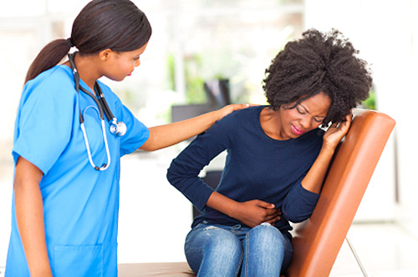
Why is it important to be able to taste?
To enjoy your favourite dinner.
To taste if something may make you ill.
Enhancing Primary Science

Slide 16
What are the five most important things you have learnt today and why?
Enhancing Primary Science

Slide 17
Of the five, which do YOU think is the most important and why?
Ask your partner and then tell them yours.
Enhancing Primary Science
Notes:
Open discussion on tables.

