Slide 1
What has happened in this photo and why is it a bad thing?
Enhancing Primary Science

Slide 2
This is a flood.
Animal habitats are destroyed and animals die.
Buildings are damaged.
Cars and other belongings are damaged.
Roads and paths are no longer passable.
This has happened after heavy rainfall and the water has not been able to drain away through the soil fast enough.
Enhancing Primary Science

Slide 3
Different Types of Soil
Further develop your understanding of different types of soil.
Describe different types of soil and run an investigation, ensuring a fair test to determine which is the most permeable soil.
Enhancing Primary Science

Slide 4
Permeable
What does permeable mean?
Enhancing Primary Science

Slide 5
Permeable means to let a liquid to flow through it.
Example:
My T-shirt is permeable because when it rained, it let water through and I got soaked.
Enhancing Primary Science

Slide 6
There are Different Types of Soil
Sandy soil
Clay soil
Gravelly soil
Peat soil
Enhancing Primary Science

Slide 7
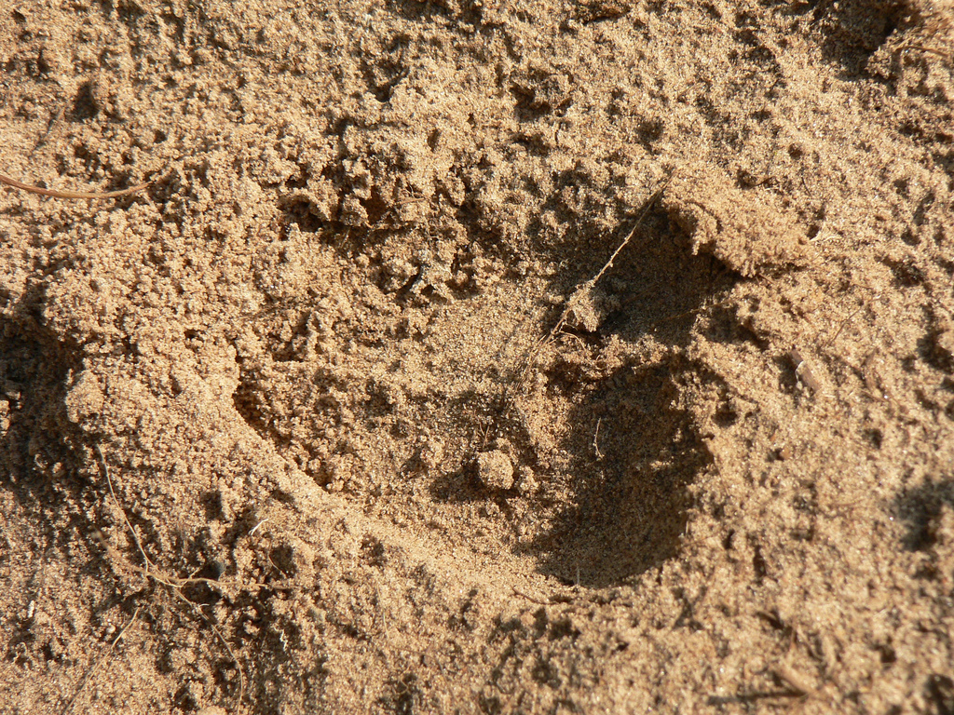
Sandy Soil
Light and dry; lots of air gaps.
Enhancing Primary Science

Slide 8
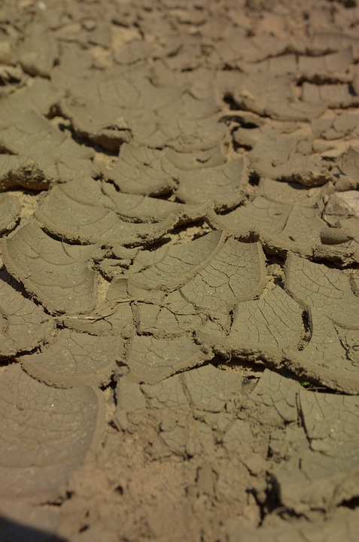
Clay Soil
This is very sticky when wet.
Enhancing Primary Science

Slide 9
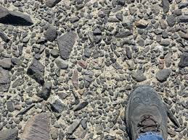
Gravelly Soil
Full of small stones.
Enhancing Primary Science

Slide 10
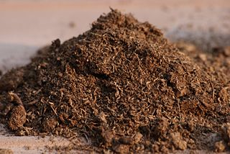
Peat Soil
Doesn’t contain rock but mostly decomposed plants (humus).
Enhancing Primary Science

Slide 11
Investigation
Enhancing Primary Science

Slide 12
Does water pass through soil at the same rate?
Aim
Prediction
Running Investigation
Method
Results
Conclusion
Enhancing Primary Science
Notes:
Open discussion on tables.

Slide 13
Aim
The aim of this investigation is to determine which soil is the most permeable.
Enhancing Primary Science
Notes:
Open discussion on tables.

Slide 14
Prediction (What do you think will happen?)
Why do good scientists make predictions?
A good scientist will always make predictions before an investigation to state what they think will happen.
I think the most permeable soil will be…
Because…
Enhancing Primary Science

Slide 15
Variables
In all investigations:
The independent variable is………
What I change. The soil type.
The dependent variable is………..
What I measure. Amount of water that flows through the soil.
The control variables are………….
What I keep the same to ensure a fair test. Amount of soil, amount of water and same amount of time we allow water to flow through the soil.
Enhancing Primary Science

Slide 16
Equipment
Soil samples
Sieve
Measuring container to collect water
Timer
Box to place used soil
Enhancing Primary Science

Slide 17
Method
Put soil into a sieve.
Place sieve into your measuring container to collect water.
Pour 250ml of water over the soil.
Set your timer going.
Measure the amount of water that has been collected in 3 minutes.
Place soil in provided box and rinse out sieve, empty out measuring container and repeat with other soil samples.
Enhancing Primary Science

Slide 18
Recording Results
Do you remember why it is important to record your results?
A good scientist will always record their results so other people can see what you have found out.
Enhancing Primary Science

Slide 19
Results
Soil type | Amount of water passed through in three minutes.
Enhancing Primary Science
Notes:
Open discussion on tables.

Slide 20
Conclusion
Make a judgement on your investigation and your findings. Use the keywords below to describe what you found out and what it means.
Soil types (use the names of the soils used) Permeable
Enhancing Primary Science

Slide 21
How have you become a better scientist today?
Talk to your friends on your table and tell them how this lesson has made you a better scientist.

